Slide 1
OS Structures 1
David Liu
Fall 2021, Spring 2022

Slide 2
Learning Outcomes
Identify services provided by an OS
Illustrate how system calls are used to provide OS services
Understand OS design with goals and specifications
Understand design principles
Understand various ways of OS implementations

Slide 3
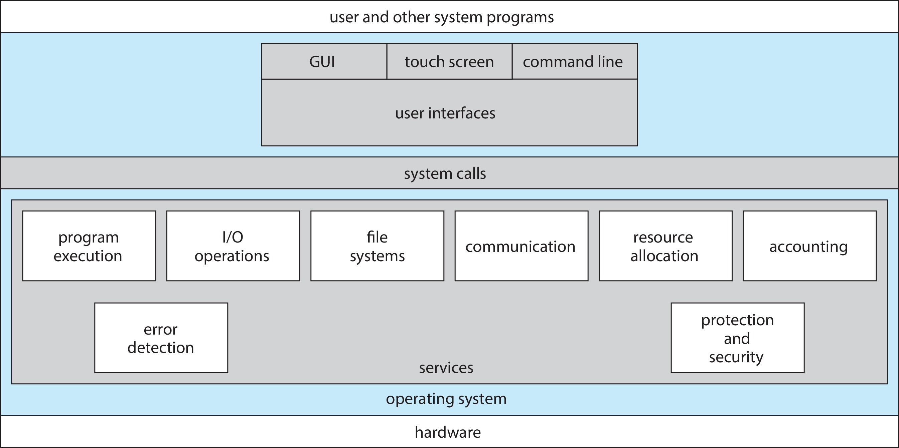
OS Services
An execution environment for programs and users
Services for users
Services for system itself

Slide 4
OS Services for Users
An execution environment for programs and users
Services for users
User interface (UI)
Program execution
I/O operations - files and I/O devices
File-system manipulation
Communications: same computer or over a network
Error detection: correct and consistent computing; debugging facilities

Slide 5
OS Services for System
An execution environment for programs and users
Services for System itself
Resource allocations
Logging
Protection and security

Slide 6
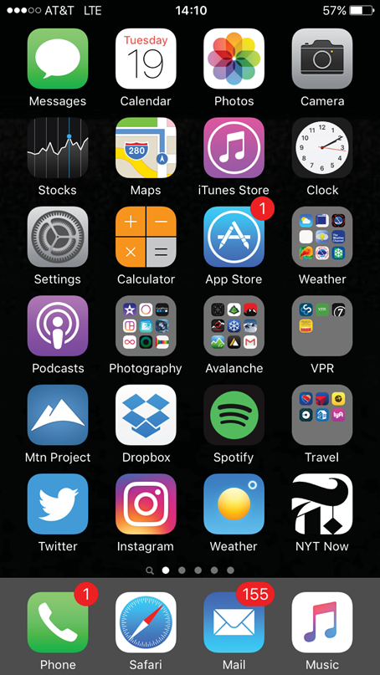
User Operating System Interface
Command interpreter (CLI)
In kernel or system programs
Shells
Graphic user interface (GUI)
Touchscreen interface

Slide 7
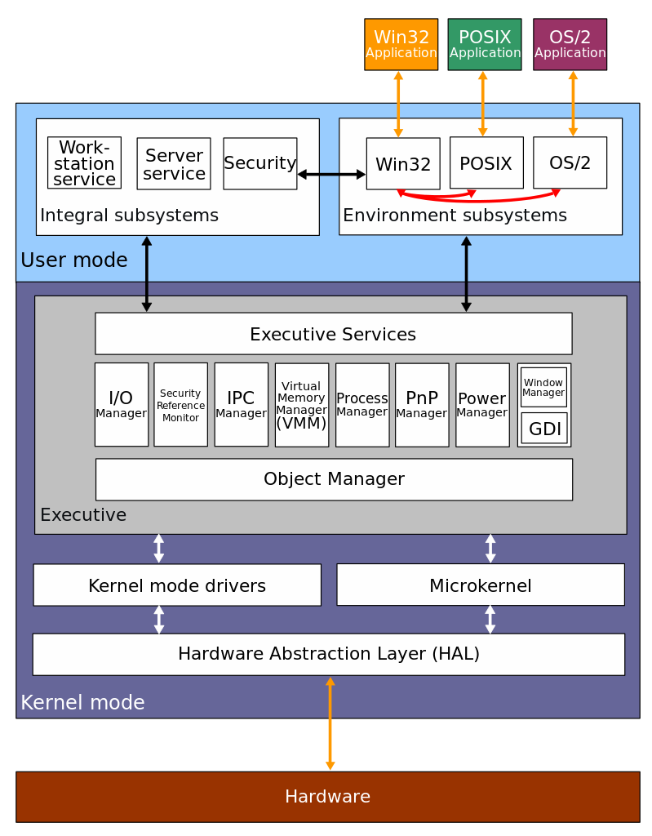
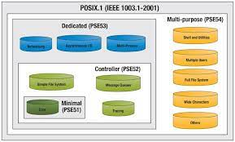
System Calls for Programs
Program access OS services through system calls
Direct system call
Application Program Interface (API)
Wind32 API
POSIX (Portable Operating System Interface) API
Java API
the Windows 2000 architecture

Slide 8
Abstraction
“The essence of abstractions is preserving information that is relevant in a given context, and forgetting information that is irrelevant in that context.”
---- John V. Guttag

Slide 9
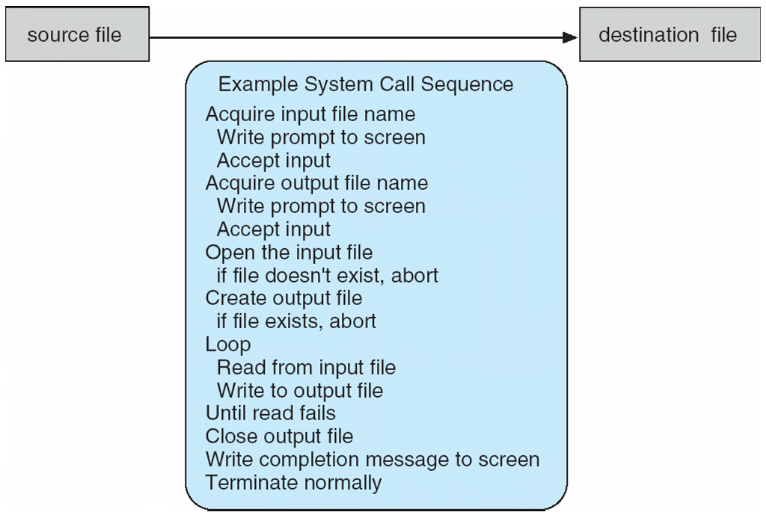
System Call Example
File copy

Slide 10
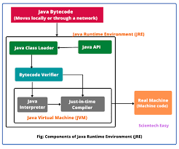
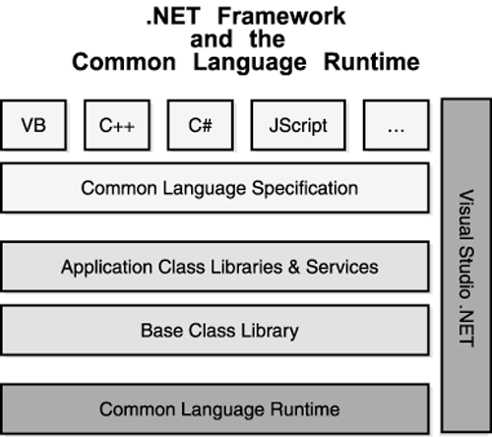
Run-Time Environment
Full suite of software needed to execute applications written in a given programming language
Provide a system-call interface
Compiler or interpreter
Library
loader

Slide 11
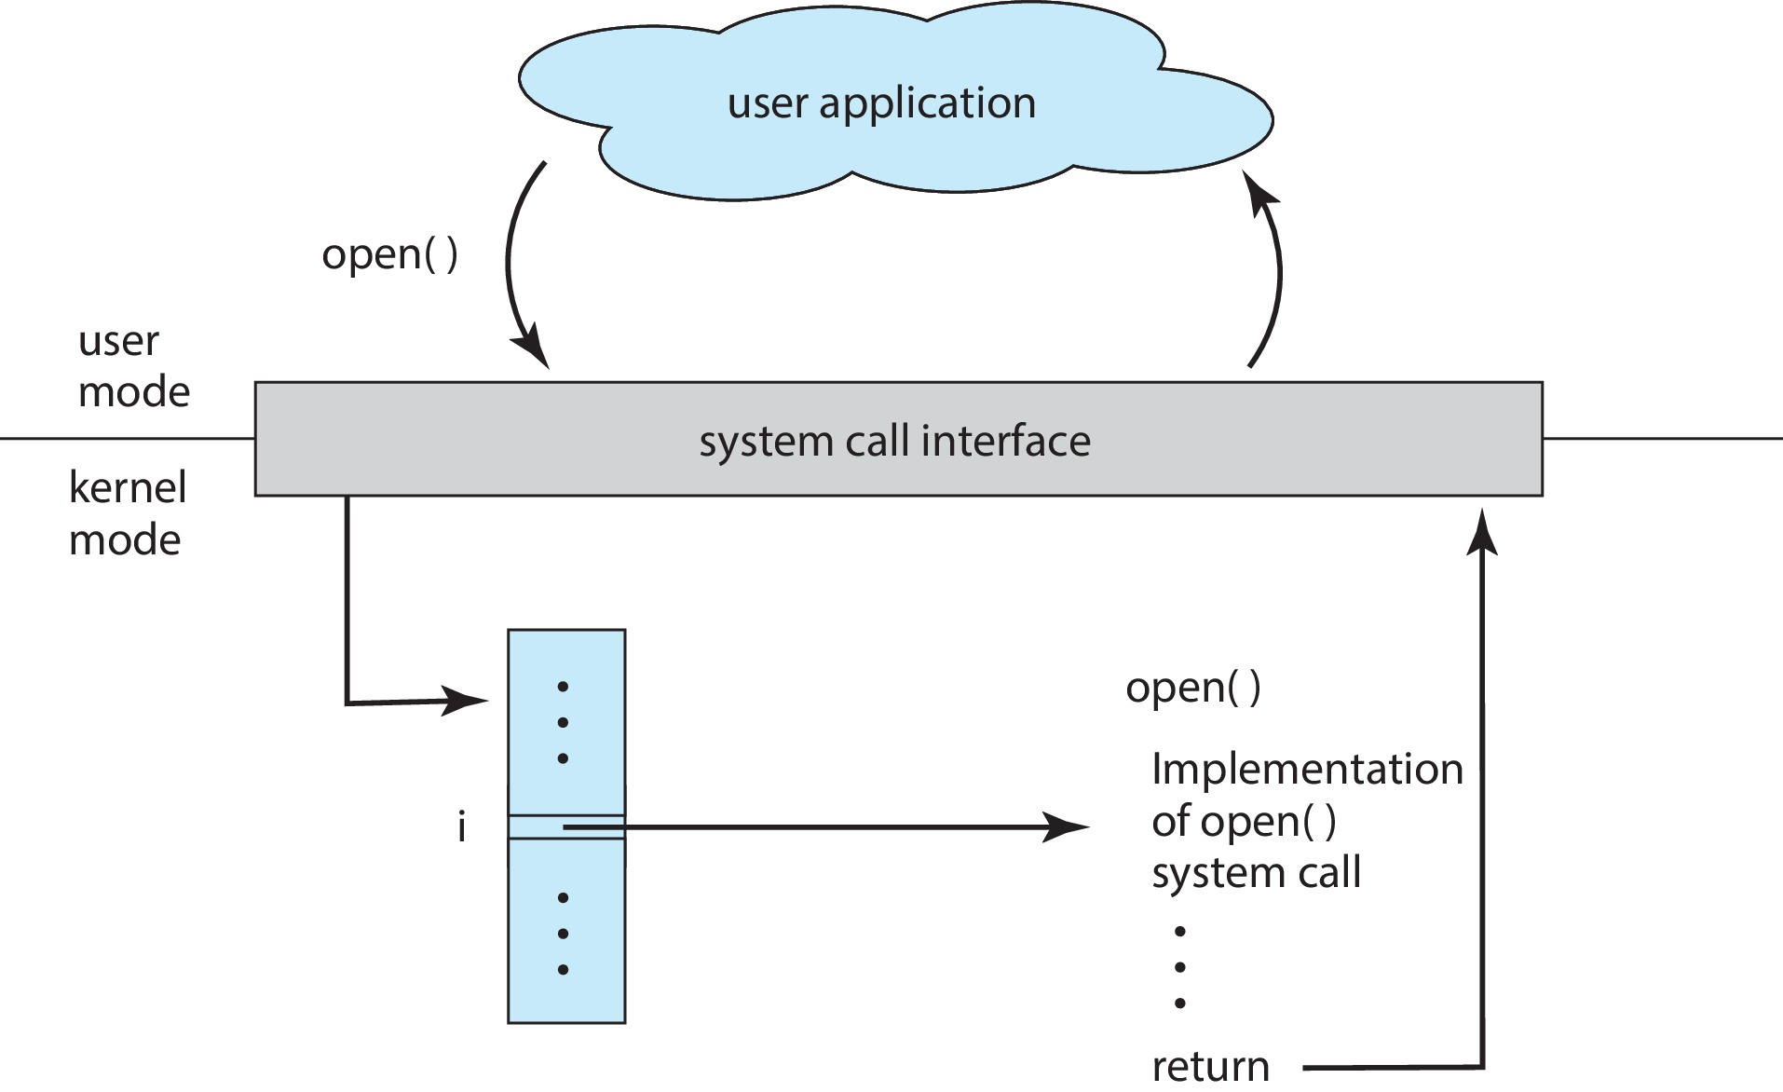
API, System Call, OS

Slide 12
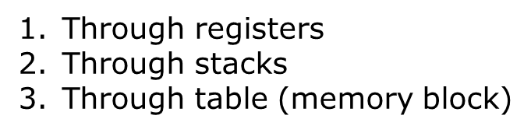

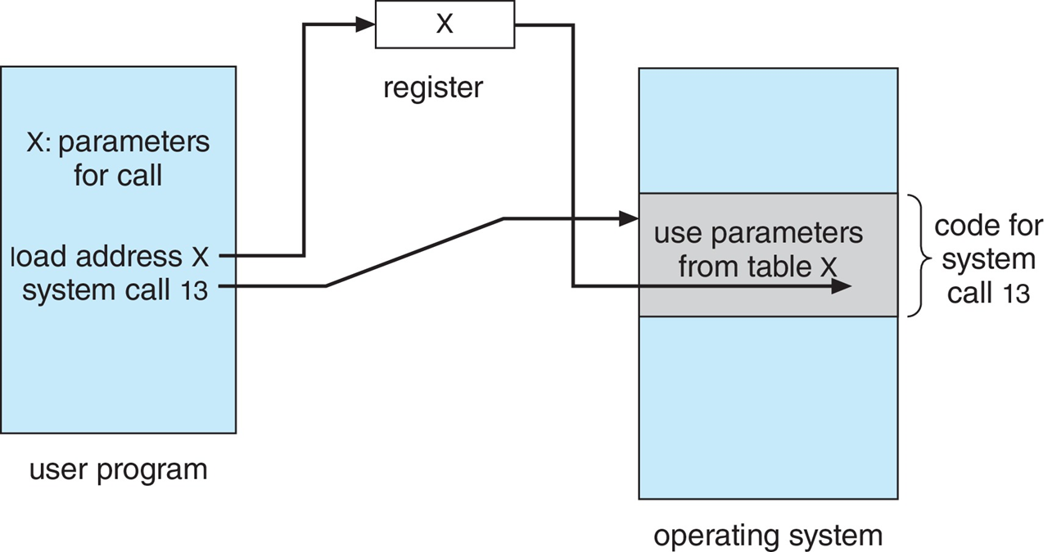
System Call Parameter Passing

Slide 13
System Call Types
Process control
create, terminate, etc.
File management
Device management
Information maintenance
Communications
Messaging passing or shared-memory
Protection
File permission etc.

Slide 14
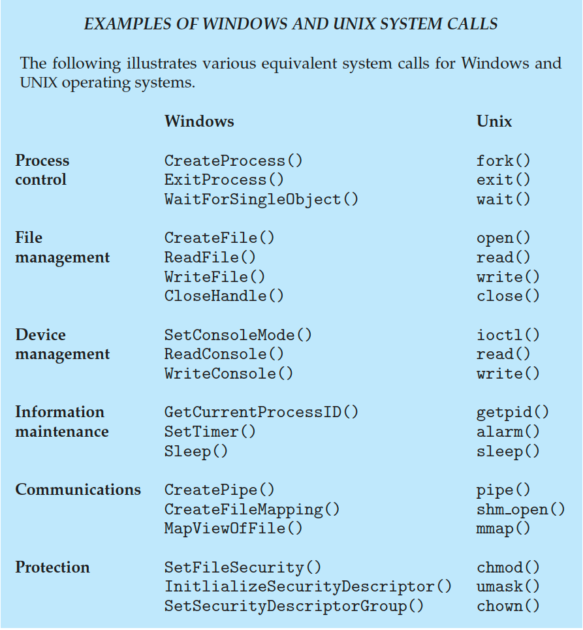
Systems Calls Windows vs Unix

Slide 15
Process Control Examples
Arduino
FreeBSD

Slide 16
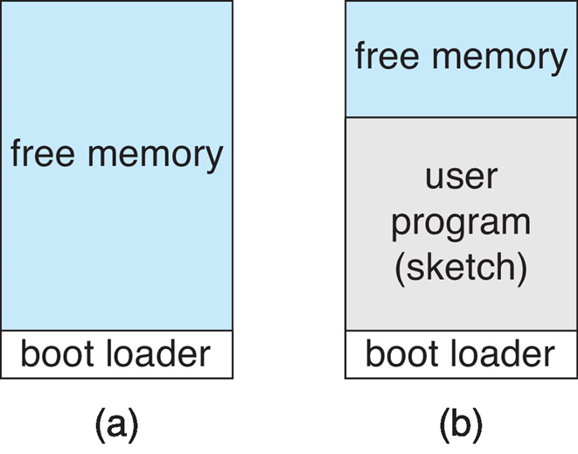
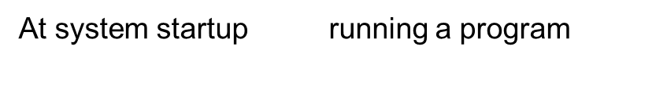
Arduino
Single-tasking
No OS

Slide 17
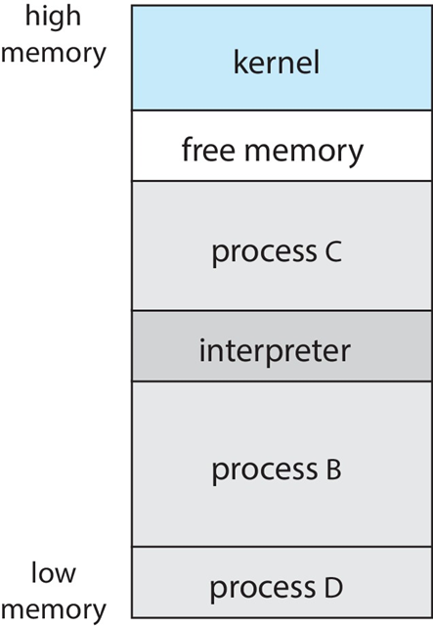
FreeBSD
Multitasking
Unix variant

Slide 18
System Services
Known as System utilities (programs)
File manipulation
Status information sometimes stored in a file
Programming language support
Program loading and execution
Communications
Background services
Application programs

Slide 19
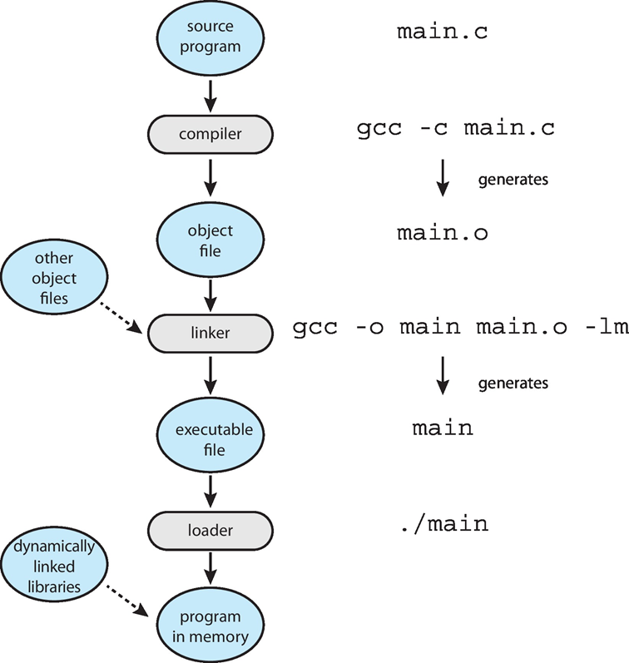
Linker and Loader

Slide 20
Object and Executable File Format
UNIX/LINUX: ELF (Executable and Linkable Format)
Windows: Portable Executable (PE) format
MacOS: Mach-O format

Slide 21
Applications Designed for Each OS
Apps compiled on one system usually not executable on other operating systems
Each operating system provides its own unique system calls
Apps can be multi-operating system
Interpreted language: Python, Ruby
Running in a VM: Java
Compiled for each OS

Slide 22
API and ABI
API: application level interface
ABI (Application Binary Interface): architecture level interface
Address width
Parameter passing to system calls
Run time stack
Binary format of system libraries
e.g. ABI for the ARMv8 processor
Application are designed and compiled for
specific Operating System
specific CPU type

